Slide 1
Adding date dimension to Model
Adding date dimension to Model

Slide 2
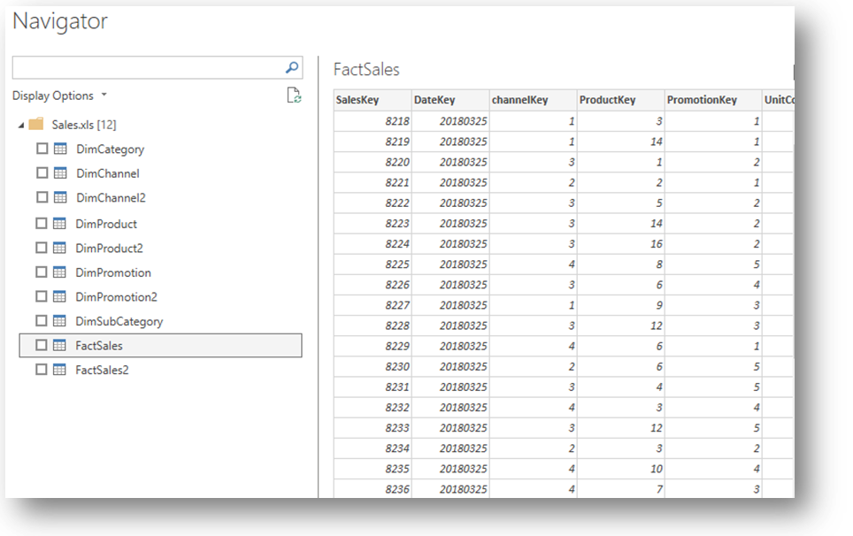
Adding date dimension to the model
Note: This Lab uses the Sales.xlsx file from the Excel Sources \ Resources folder
Open Sales.xlsx file into the editor and select some dimensions and the Fact Sales table

Slide 3
Adding date dimension to the model
Generate the a date dimension table
Date =
VAR MinDate = DATE(2018, 1, 1)
VAR MaxDate = DATE(2021, 12, 31)
RETURN
ADDCOLUMNS (
CALENDAR(MinDate, MaxDate),
"Calendar Year", "CY" & YEAR([Date]),
"Month Name", FORMAT([Date], "mmmm"),
"Month Number", MONTH([Date]),
"Date Key", YEAR([Date]) * 10000 + MONTH([Date]) * 100 + DAY([Date])
)

Slide 4
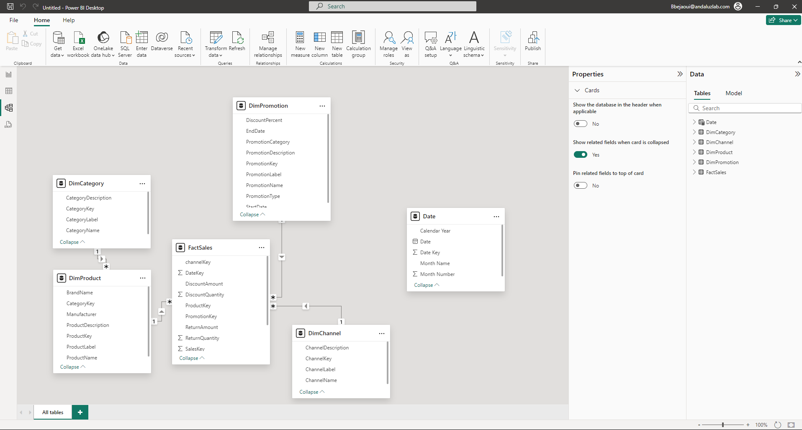
Adding date dimension to the model
Switch to the model view and drag and drop DimDate[DateKey] to FactSales[DateKey]

Slide 5
Thank you
Thank you

